Slide 1
Microsoft Lists Adoption Playbook
https://aka.ms/ListsAdoptionPlaybook

Slide 2
Welcome! This guide will help you implement Microsoft Lists within your company. The Success Factors outlined in this deck will help make sure you’re set up for a successful roll-out.
Throughout this deck, you will find templates to help you facilitate your organization’s Lists adoption campaign.

Slide 3
Introduction to Microsoft Lists
Why Lists?
Microsoft Lists provides a simple, smart, and flexible way to organize work and track the information that matters most to your business.
Create and share lists that help you track issues, assets, routines, contacts, inventory, and more.
See more by downloading the Lists Look Book or exploring the ways Lists is used throughout a typical day in the Day in the Life One-Sheets

Slide 4
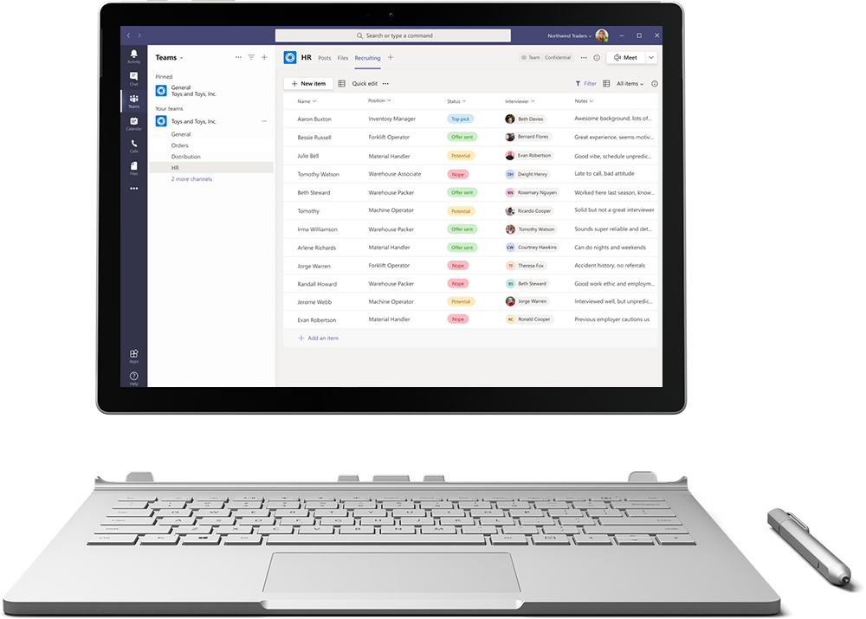
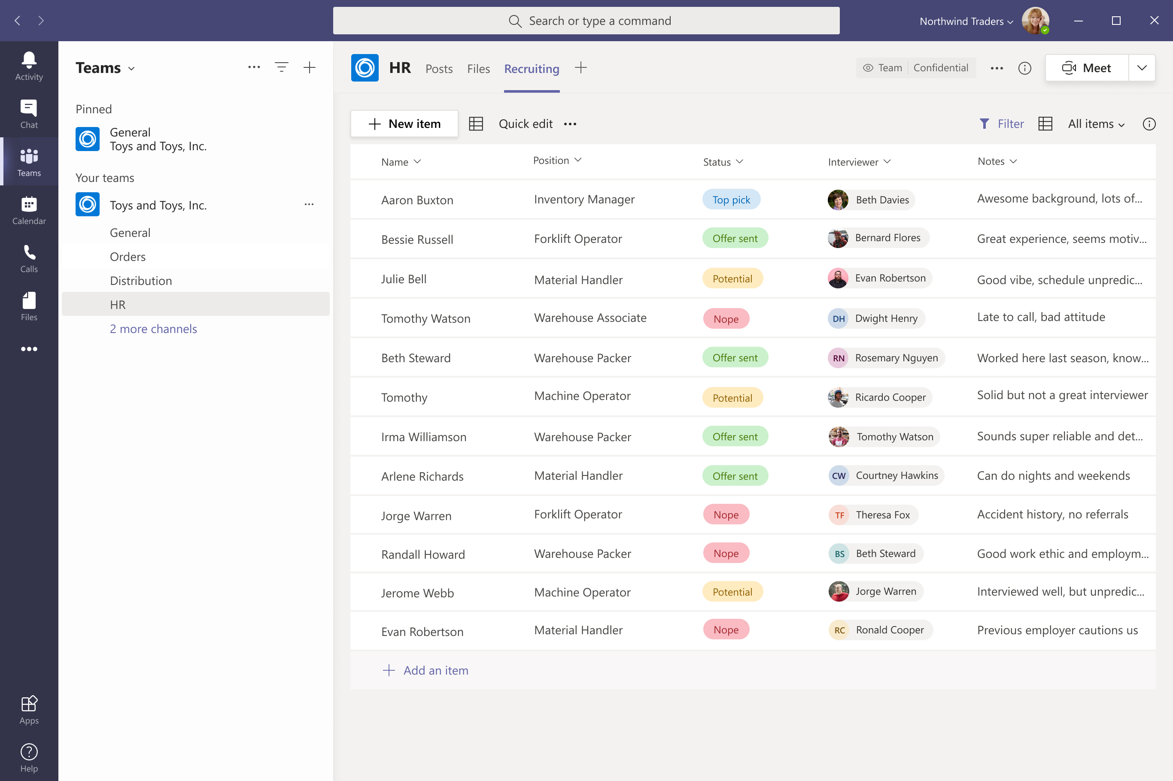
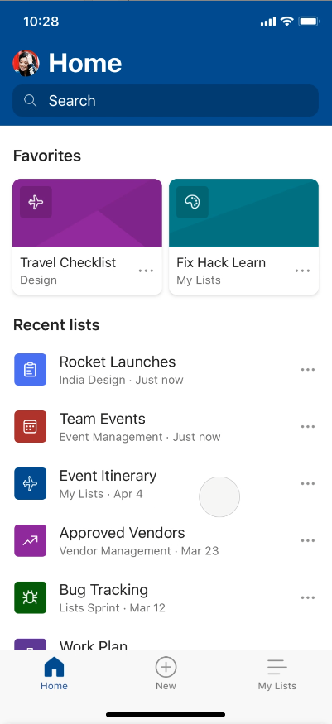
Track what matters most with Microsoft Lists
Simple
Easily create, share, and track lists with anyone, on any device
Smart
Keep everyone in sync with rules and quick edits
Flexible
Customize your lists for whatever your business needs
Click for the downloadable look book
Notes:
Throughout this presentation, I’m going to cover some of the ways we’ve designed Lists to be simple, smart, and flexible to help you track what matters most.
Lists are simple—they are easy to create, easy to share, and accessible across several different devices. You can start the web app using the Microsoft 365 App launcher. Coming later this year, we will have a mobile application that provides full functionality through your phone.
Lists are smart—we are building them with capabilities that help you keep everyone in sync without requiring a lot of time on your part. For example, we’ve made it easy to develop rules based on the type of information you're tracking, so when something in a list changes it triggers an e-mail or tags someone through an @mention so the right people are alerted at the right time.
You can enhance your Lists experience by running it inside Microsoft Teams alongside the other collaboration features —the way it is shown here on the laptop screen. Simply add the Lists app as a new tab in Teams and import an existing list or build new.
Lists are flexible—from configuring and color-coding to conditional formatting and integration with Power Platform, you can choose simple or dynamic rules and views to help you get the most out of your list.
📺 Additional on-demand webinar to share, "Working with Microsoft Lists" webinar: https://aka.ms/MSLists/GA/webinar
📃 Initial disclosure blog, "Announcing Microsoft Lists - Your smart information tracking app in Microsoft 365" by Seth Patton, GM, Microsoft 365
📃 General availability blog, "Microsoft Lists begins general availability roll out to Microsoft 365": https://aka.ms/MSLists/GAblog by Seth Patton
🌐 Microsoft Lists product page on MS.com (at GA): https://aka.ms/MSLists/GA/web

Slide 5
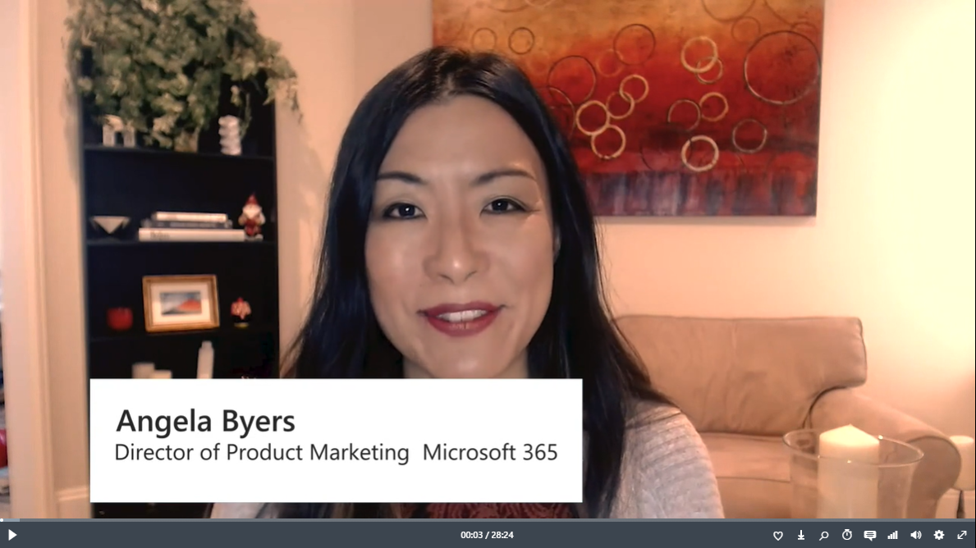
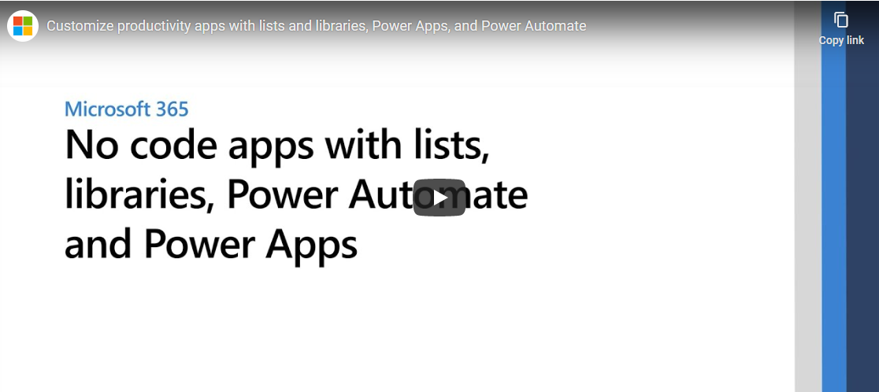
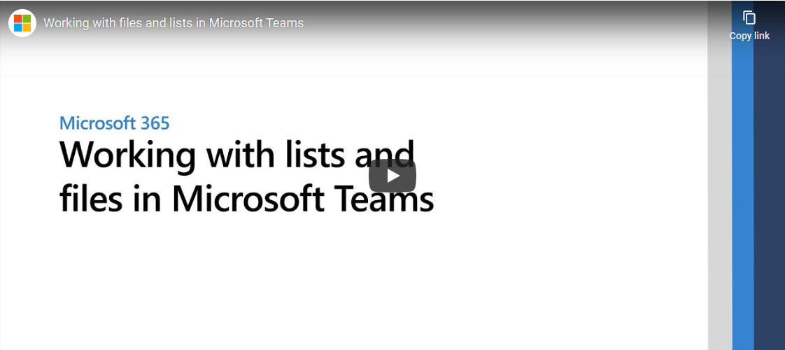
Understanding Microsoft’s vision
Embrace a new way of work with Microsoft 365
In an unprecedented time of workplace transformation, opportunities to thrive belong to those who embrace and adapt to the new normal. How do we collaborate remotely, stay connected and produce excellent work as a team? How do we stay productive while working from home? Join us for a new way to think about and manage work with Microsoft 365. Learn how Microsoft 365 makes it easier for your team to organize, share and track work all in one place – so you save time and accomplish more together.
Watch video
Customize productivity apps with lists and libraries, Power Apps, and Power Automate
No-code and low-code apps have been essential in SharePoint for a long time. Additional tools from the Power Platform - Power Apps and Power Automate - provide additional power and capability to build productivity apps using SharePoint lists as the data source. In this demo-heavy session, see how Microsoft Lists can connect with external data sources and help keep business on track. Power Automate integrations bring the tools you’ll need to enable high-value workflow solutions, including data retrieval, automation and insights.
Watch video
Work with lists and files directly inside Microsoft Teams
Get the most of working with lists and files directly inside Microsoft Teams. We'll walk thru numerous scenarios when using the new Lists app in Teams and benefitting from the Files tab integration with the power of content services powered by SharePoint. In this session we will cover a breadth of innovation when working with information and documents across how you access, share and collaborate on lists and files within Teams channels you use.
Watch video
Notes:
Embed MW videos

Slide 6
Scenarios for Success with Microsoft Lists
Get inspired by reviewing these scenarios that take you through a “day in the life” of several roles
Joe: Human Resources Manager
Sarah: Marketing Manager
Emily: Service Engineer
Jordan: Supply Chain Manager
Download the deck >
Day in the Life Sheets >
Notes:
Day in the life for each role
Marketing
Sales
Compliance
Finance
Retail Manager
Retail Associate
Service Engineer

Slide 7
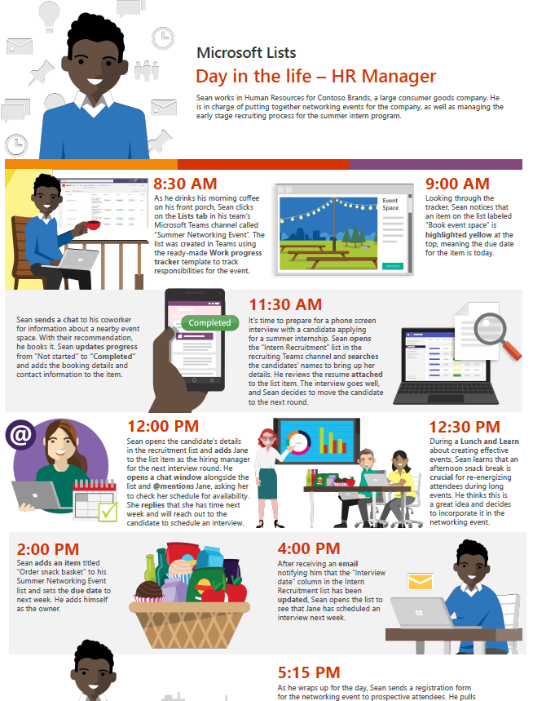
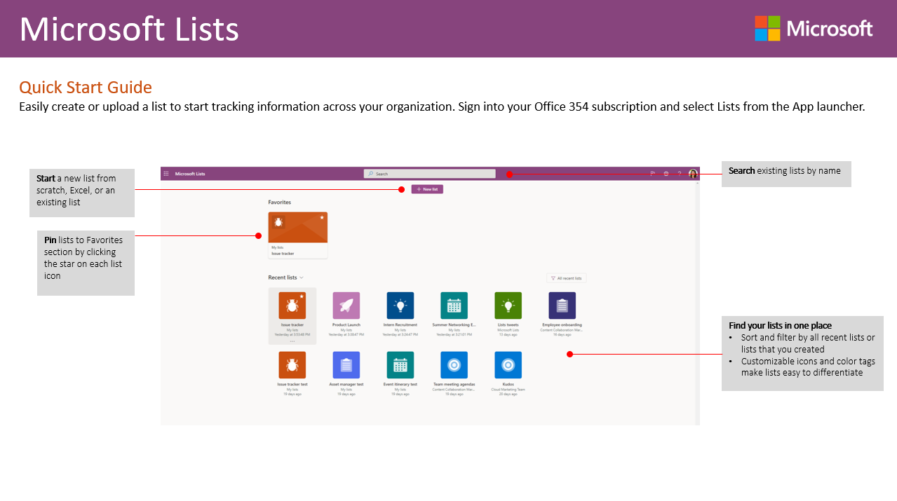
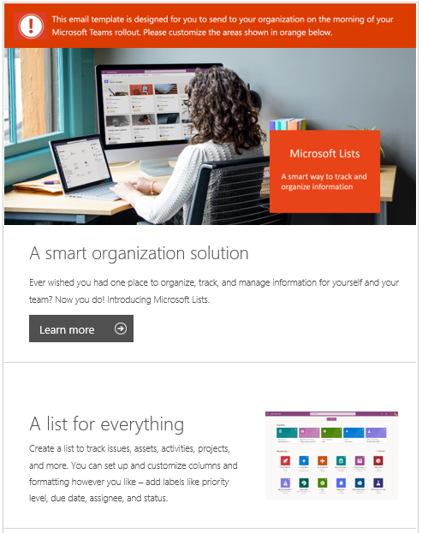
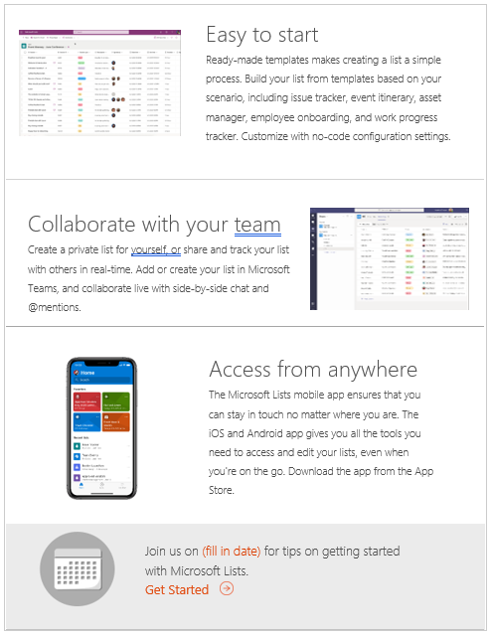
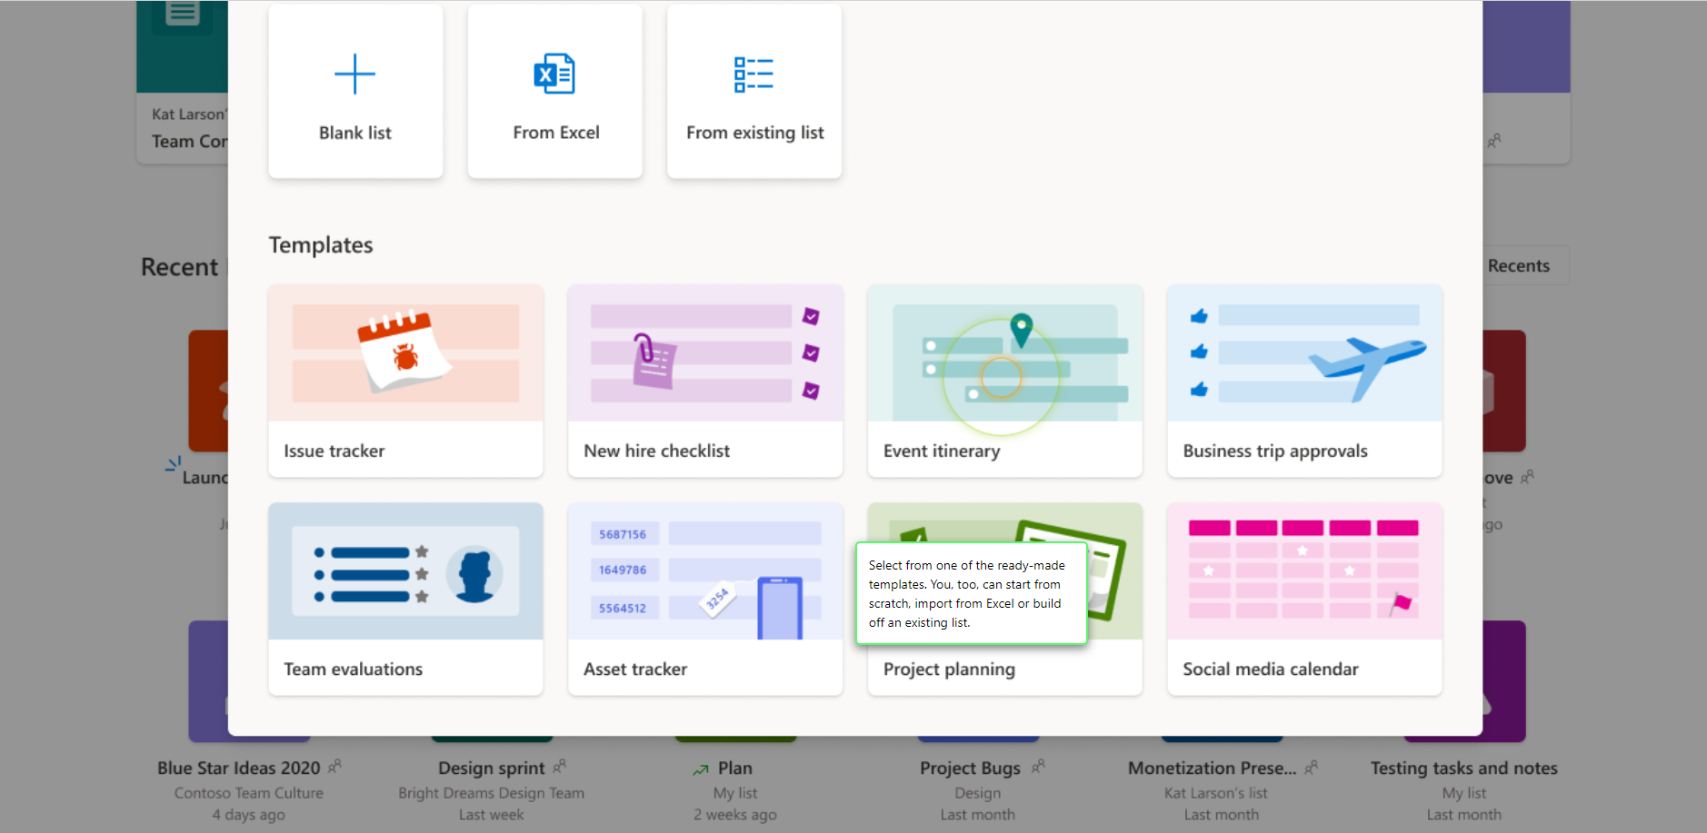
Lists Adoption Kit
Download the resources from the Lists Adoption page to support Lists adoption at you or your customer’s organization, including a Getting Started Guide, editable email templates and flyers, Scenario sheets, click through demos, and more.
Check it out at aka.ms/ListsAdoption
Notes:
Quickstart Guide
Product flyer
Countdown flyer
Tips email template 1
Tips email template 2
Scenario deck and one-sheeters
Product deck
Click through demo

Slide 8
Adoption Success Factors
LEARN AND REINFORCE
Stakeholders
Recruit executive sponsors
Empower Lists champions
Scenarios
Prioritize your Lists scenarios
Measure success
Awareness
Implement Lists comms campaign
Execute Lists launch events
Training
Train end users
Ready help desk
Microsoft 365 Adoption Workbook: Sample templates and outlines for your adoption plan
Aka.ms/M365AGWorkbook

Slide 9
Stakeholders

Slide 10
Stakeholders
Executive sponsors
Communications to all staff and supporting sponsors/leadership
Act as sponsor and face to the program
Use the technology to model how employees can use it
Success Owner
Ensure business goals set for Lists are realized
Drive end user adoption
Champions
Scale adoption efforts across the organization
Evangelize Lists and its value across teams
Welcome new users and answer questions
Mott MacDonald developed a network of technology champions by engaging the employees who are most interested and enthusiastic about the new capabilities.
The company makes sure the champions are well-trained and sends them out into the business to coach and communicate with their colleagues.

Slide 11
Executive Sponsor Communications
Executive Sponsor
Supporting Sponsors
Employees
Key messages
Outline the project’s 5 Ws (what, when, where, why’ and how)
How will benefit organization
Calls to action for supporting sponsors
Highlight resources to support transition
Key messages
Outline the project’s 5 Ws (what, when, where, why’ and how
How will benefit organization and end users
Calls to action for employees: start and stop behaviors
Highlight resources to support transition

Slide 12
How does a Champion help?
Info
Support
Enthusiasm
Answers
Keep your team up-to-date on what’s coming and when
Be on hand to answer questions and help get support involved when needed
Answer ad-hoc questions and demonstrate features
Help show your team the advantages of Lists

Slide 13
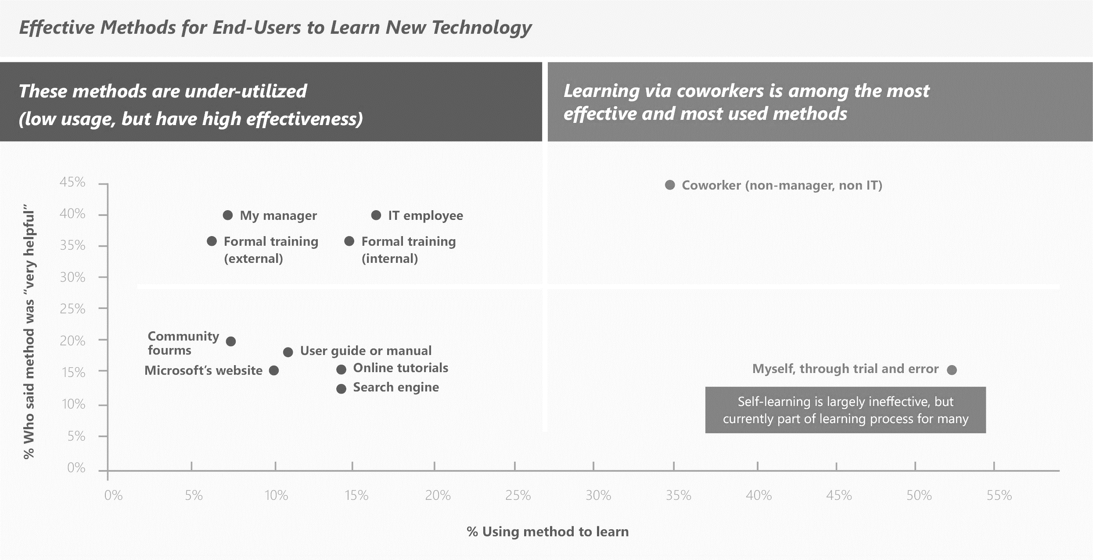
Why are Champions important?
Learning via coworkers is among the most effective and most used methods
In a Microsoft End-User study, research indicates learning from co-workers is among the most effective and used methods in learning a new technology
SharePoint End-User Study, Apr 2013, Microsoft Corporation

Slide 14
Office 365 Champions Program
Stay Informed and Connected
Get your champions to sign up for this Microsoft led community, you’ll have access to following opportunities:
Regular email communications (community topics, latest news, tips and resources)
Regular champion-peer networking and sharing
Partnerships with Microsoft at premier events and meetups in your industry
Access to Microsoft subject matter experts and unique Office 365 training and content
https://aka.ms/O365Champions

Slide 15
Stakeholders
Stakeholder Group | Who
Executive Sponsor
Supporting Sponsor(s)
Success Owner
Champion(s)

Slide 16
1
Plan executive sponsor communications
Use Executive Communications Planning deck
https://aka.ms/SharePointExecCommPlan
2
Build champions program
Create a plan using the Champion Program Plan
https://aka.ms/SharePointChampionProgramTemplate

Slide 17
Scenarios

Slide 18
Identify Scenarios
Why Scenarios are important:
What is a Scenario?
Scenarios cover the ways your people will use Lists to address business challenges or achieve defined goals.
Allow teams to understand how Lists can help them achieve more
Act as inputs and validation of Lists awareness messaging
Support awareness and readiness activities by putting products in context; people will know when and how to use them
Check out the Lists Scenario One-Sheeters for a few examples of how Lists can be used across roles and functions
Download here

Slide 19
How to create your own Scenarios
I want to…
[Description of what I want to do]
Using…
[Specific application of the technology]
I know this is successful when…
[Solution success measure]
As someone in…
[Team]
As someone in
Product Management
I want to
Track the feature roadmap across my team and have all related resources/updates in one place
Using
Microsoft Lists to create a list that lists upcoming features, progress, disclosure status, feature owners, notes, and announcement activities
I’ll know this is successful when
The whole team and related teams is aware of the feature roadmap, and features are launched and amplified successfully

Slide 20
Tips for identifying scenarios
Decision Criteria:
Does it solve a real problem?
Is it obtainable?
Will it be widely used (how many people)?
How much ROI does it provide?
Notes:
Use this slide to help guide the initial creation/ideation of solutions.

Slide 21
How to prioritize your Scenarios: Impact vs ease of implementation
High
Med
Low
Medium priority | High priority
Low priority | Medium priority
(Copy these to map!)
Scenario name
Scenario name
Impact
Scenario name
Scenario name
Scenario name
Scenario name
Scenario name
Add your scenario’s name and add as many as needed
Hard
Somewhat
Easy
Ease of implementation
Notes:
Choose a Scenario!
This activity should take place on a whiteboard, use this template to get started. You will also use this template to capture results of the whiteboard exercise and then circulate.
Additionally it is recommended you use sticky notes to represent each solution and have participants place them and move them around on the whiteboard
Identify and agree upon which scenario you are going to focus on.
Encourage everyone to voice their opinions (try not to let one “decision maker” taker over)
Steer them towards choosing a scenario that:
Is obtainable (doesn’t have to be easy, but it has to at least be possible to create in a short amount of time)
Will be used by at least 90% of their employees (or better yet, 100%!) – don’t pick ones that will only be used by the C-level, or managers and up, because ROI will be minimal. Pick something that lifts the entire population up.
Is collaborative. Scenarios that allow employees to interact and collaborate demonstrate the real value of Teams.
Agree on which scenario you will be focusing on. Get everyone’s buy-off! You will need at least one BDM to agree that this is a priority—get an executive sponsor!

Slide 22
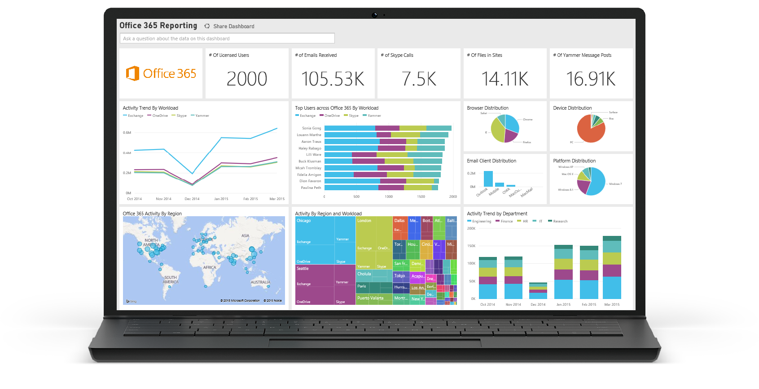
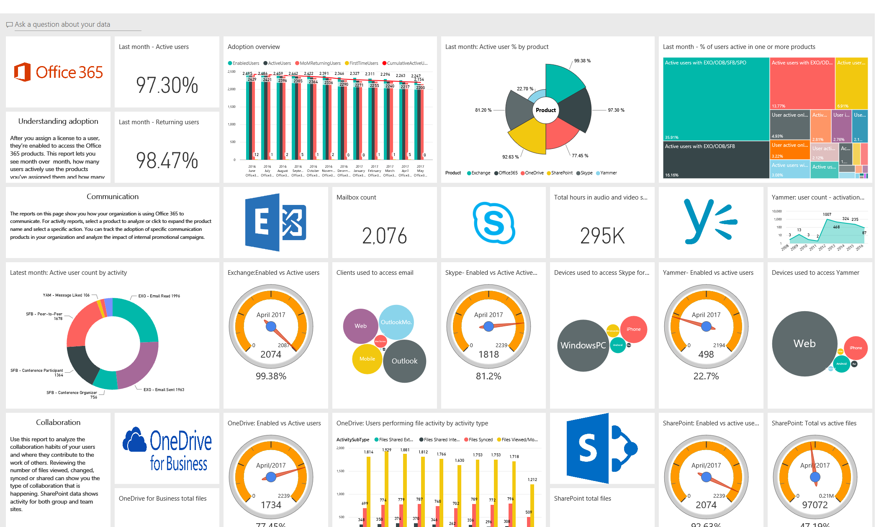
Measure with Microsoft 365 Usage Analytics
Microsoft 365 Usage Analytics
Basic OneDrive usage reports available in the admin center: Instructions on how to access and interpret the report are here

Slide 23
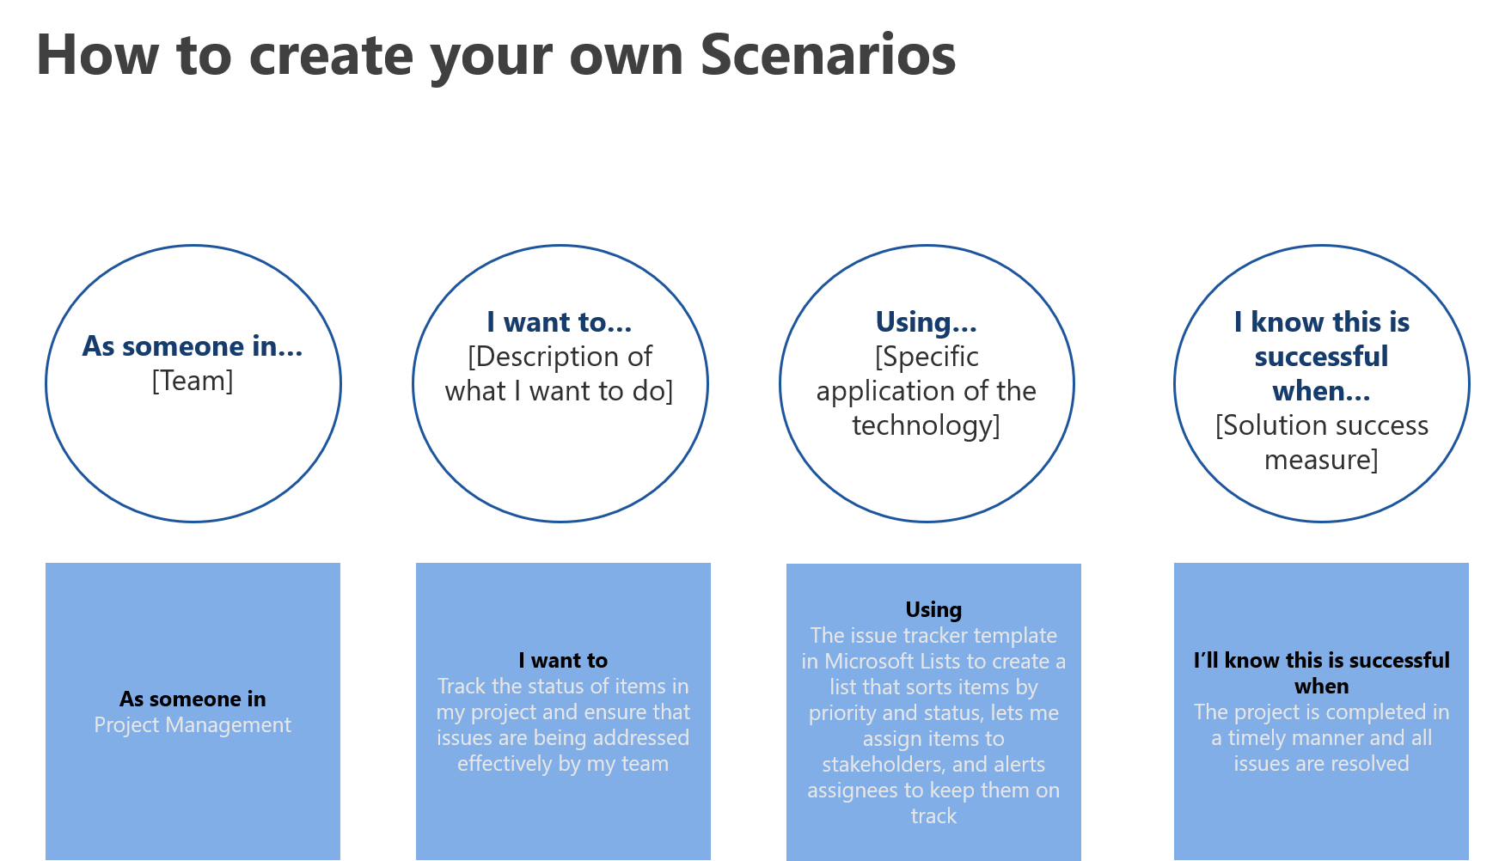
1
Identify and prioritize Lists scenarios
Work with your business decision makers to identify Lists scenarios
Example: https://aka.ms/SharePointEnvisioningWorkshop

Slide 24
Awareness

Slide 25
Awareness
Teaser Campaign
First Day Set Up
Tips Campaign
Campaign to raise awareness regarding the value Lists will provide
Highlight scenarios of value that Lists will provide to organization and key roles
Generate excitement and awareness regarding the app
Gain staff buy-in for project by outlining ‘what’s in it for them’
“We got this” Lists video
Communication and guide(s) to help end users get set up quickly and easily
Campaign focused on key tips for Lists to help employees get the most value from working in new ways
Make it top of mind for staff regarding how to work in new ways with Lists
Reinforce new behaviors and resources to support – outline key stop, start, continue behaviors
Tips email campaign templates can be found at aka.ms/ListsAdoption
Launch/Buzz Campaigns
Campaigns to kick-off Lists launch and support adoption post-launch
Scenario-focused events and email campaigns that showcase the user experience
PRE-LAUNCH
LAUNCH
POST-LAUNCH

Slide 26
Plan Communications
Define Objectives
Outline Audiences
Determine
Key Messages
Identify Senders
Outline Channels
Identify objectives for communication(s)
Define audiences for communications, including end user personas and project stakeholders (Sponsors, leadership, champions)
Answer the 5 Ws (who, what, when, where, why) and how
Outline the key project benefits for audiences
Identify senders that can influence key audiences identified
Outline how sponsor/success owner and champions can help amplify and scale key messages
Identify the channels that your key audiences engage with/on

Slide 27
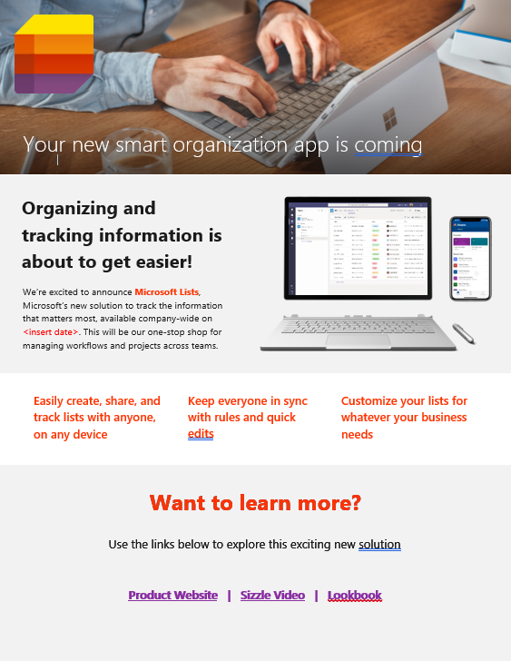
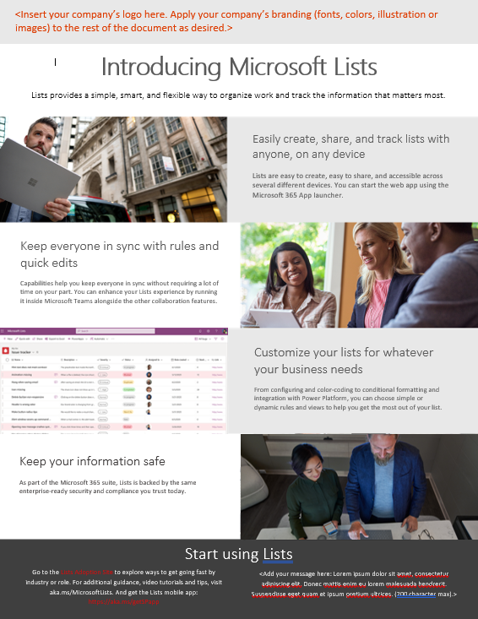
Use Available Templates
Download resources at aka.ms/ListsAdoption
Teaser Campaign
Announcement news post sample
Email Templates

Slide 28
Plan Launch/Buzz Campaigns
Resources and tactics for an effective launch
How to choose your launch event:
Consider your goals for using Lists. How can your launch event support these objectives and these particular parts of the business?
Consider your company culture. What types of activities will resonate with your leadership and your employees?
Consider your time and resources. Can you mix and match different event activities to plan something that suits your needs and fits into your schedule?
Consider existing company events. Is there an upcoming company event near the roll-out of Lists that could incorporate your launch?
The following are some resources, ideas, and tactics to help create an effective Lists launch:
Key note from executive sponsor to kick off event
Run online engagement events using Microsoft Teams live events for team members in remote offices
Email roundup with Lists flyer, FAQs, look book, and Sizzle/teaser videos

Slide 29
Encouraging
Ongoing Engagement
Increase Lists adoption over time with ongoing awareness and training activity.
Create a Yammer group to continue conversation on best practices and new features
Share success stories as to how people are using Lists in innovative and impactful ways
Periodically host additional engagement events like town hall meetings or lunch & learns to drive end user engagement
Set challenges for people and run competitions to celebrate the best ways they’ve used Lists to do work differently

Slide 30
1
Plan awareness campaign with communication plan template
Use Sharepoint Communication Plan template as an example to plan your awareness campaign
https://aka.ms/SharePointCommPlanTemplate
2
Plan launch event
Use the Launch/Buzz Event deck to plan your launch event
https://aka.ms/SharePointLaunchEventPlanning

Slide 31
Training

Slide 32
Training
Plan
Deliver Training
Deliver Training
Goals, audience, scenarios & methods
Develop and update training materials
Online, self-paced & instructor led
Online, self-paced & instructor led
Train the Trainer
Train the instructors, helpdesk & champions
Deliver Training
Online, self-paced & instructor led
PRE-LAUNCH
LAUNCH
POST-LAUNCH

Slide 33
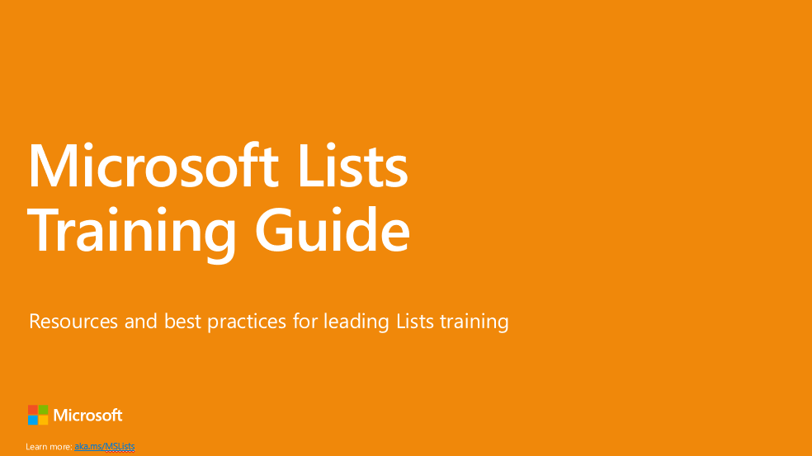
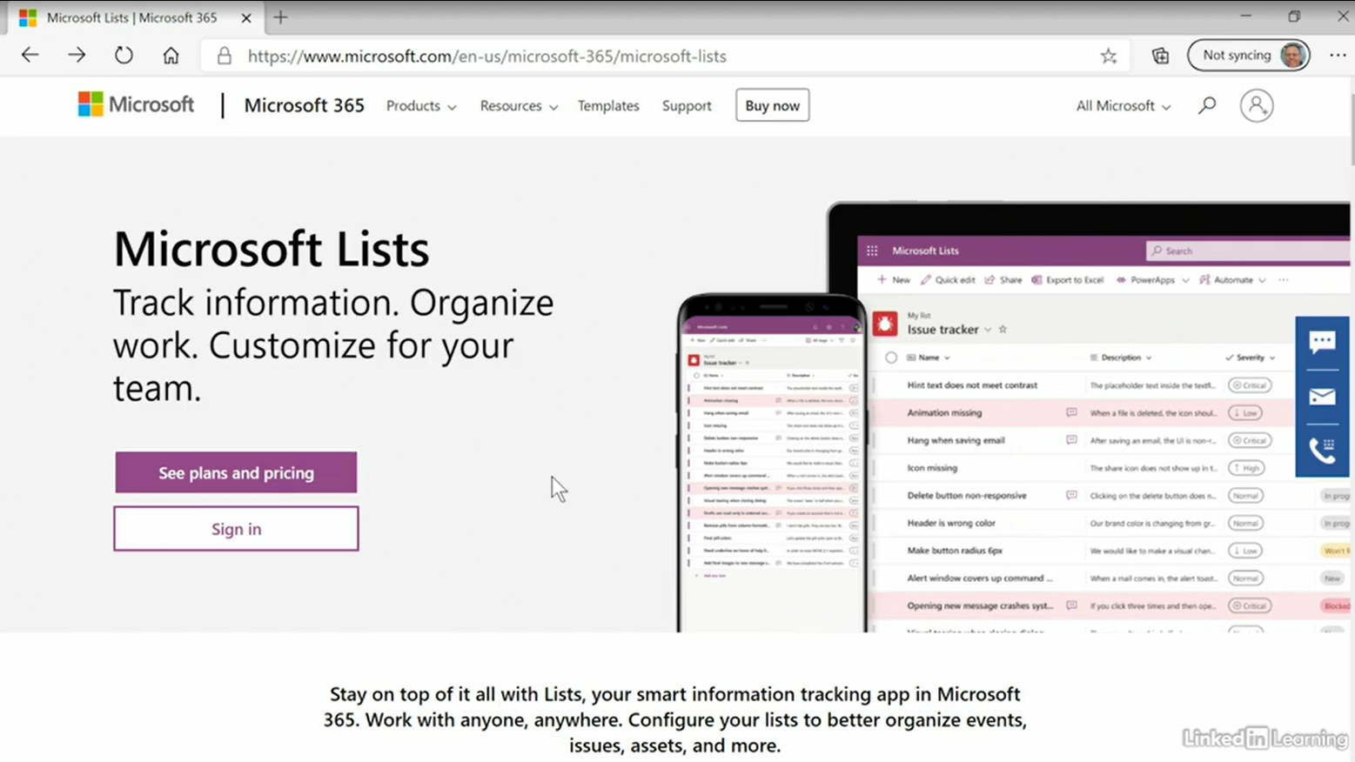
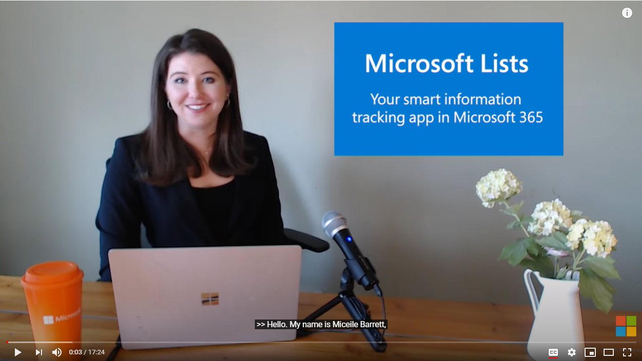
1
Develop training plan
Use Lists Training Guide to build your training plan
https://aka.ms/ListsTrainingGuide (download)
2
Train help desk, champions, and training instructors
Use the resources section in the Lists Training Guide (above) to train the trainer
Linkedin Learning Course
Lists Click-through Demo
Lists Demo Video
3
Deliver training
Aka.ms/ListsLinkedinLearning
Aka.ms/ListsClickThrough
Aka.ms/ListsDemo
Use the available training materials to train end users

Slide 34
Next Steps

Slide 35
Next Steps
1. Build project plan using example template - https://aka.ms/SharePointAdoptionCampaignPlanTemplate
2. Execute using available Lists templates, resources, and materials –
https://aka.ms/ListsAdoption
3. Launch

